Slide 1

MACHINE LEARNING BASED DETECTION OF BREAST CANCER USING LOGISTIC REGRESSION(MH-6)
-BY
THE MUSKEETERS
M.A.M.C.E.T

Slide 2
PROBLEM STATEMENT
The diagnosis of breast cancer involves classification of its tumor cells into malignant and benign group into subject of much research.
The future prediction of benign or malignant of a patient is more complex.
Logistic regression model in machine learning will be used for prediction and accuracy using pretrained models.

Slide 3
PROBLEM SOLUTION
Further classification of benign tumors can prevent patients undergoing unnecessary treatments.
Because of its unique advantages in critical features detection from complex BC datasets, machine learning (ML) is widely recognized as choice in Breast Cancer pattern classification and forecast modelling.

Slide 4
RISK FACTOR OF BREAST CANCER
The breast cancer is accured in various factor depending upon the patient(host).
However most case of breast cancer cannot be linked to a specific cause .
FACTORS:
Age
Genetic factors
Family history of breast cancer
Childbearing & Menstrual history

Slide 5
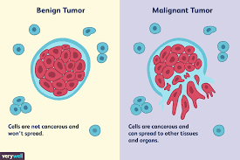
BENIGN AND MALIGNANT TUMOUR

Slide 6
UNDERSTANDING DATASET FROM DATA
The dataset which takes a part of this is available publicaly was created by Dr. William H.Wolberg physician at the University Of Wisconsin Hospital at Madison, Wisconsin, USA.
The dataset here describes the characteristics of the cell nuclei present in the image as math values with various attributes of information. And the data is given to pathologist to examine whether the cell is normal or not. Here we are using the recorded math values as dataset for our idea.

Slide 7
ATTRIBUTES REQUIRED FOR DETECTING CELL
Id(number)
Diagnosis (M = malignant, b-benign)
Radius(mean distance from center to points on the perimeter)
Texture(standard deviation of gray scale values)
Perimeter
Area
Smoothness(variance in radius length)
Compactness of the cell
Concavity (rate of change of the cell from one to another)
Symmetry of the cell
Fractal dimension (how complicated the cell grows)

Slide 8
OBJECTIVE
The information which we have analyzed helps us to predict whether the cell is Benign or Malignant and to choose model selection and hyper parameter selection.
Our ultimate goal is to classify whether the breast cancer is benign or malignant.
To achieve this we have used various machine learning classification methods to fit a function that uses testing and training of dataset for better score of accuracy in outcome.

Slide 9
DATA EXPLORATION PHASE 1
Here we are Using Jupyter notebook to work on this dataset.
We import necessary inbuilt packages required for data exploration.
The data set is imported with the help of pandas(pd) package for structuring the data set as numerical table.
After importing the dataset we have to examine it by head() and tail() function to view sample data from dataset
If the data has any unnamed field it must be removed or to be imputed with a meaningful values in the dataset.
Necessary visualization of graph with the seaborn package is visualized from the dataset.

Slide 10
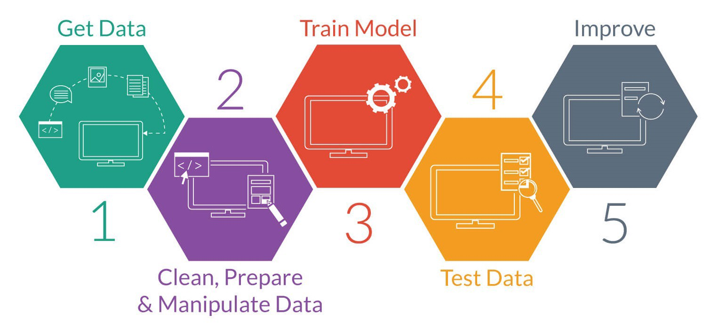
LOGISTIC REGRESSION STEPS

Slide 11
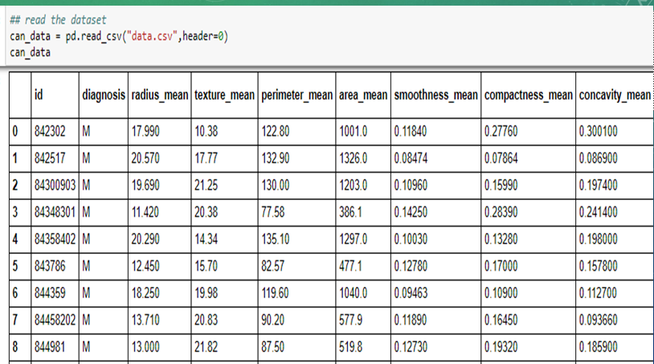

Slide 12
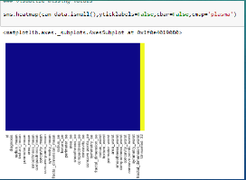
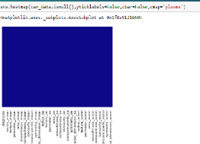
VISUALIZING THE MISSING VALUES
AFORE
BACKOF

Slide 13


CATEGORICAL DATA-PHASE 2
Using label encoder to(text to number) label the categorical data.
We denote malignant as “ 1” and benign as “ 0”.

Slide 14
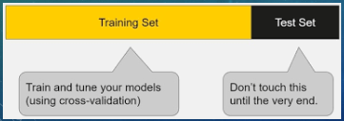
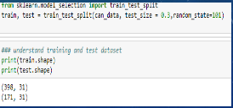
SPLITING DATASET
Here we are splitting the dataset with the help of Scikit Learn package
Splitting of dataset as two set
1. Training the data set 2.Testing the data set
.

Slide 15
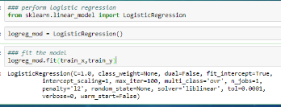
CHOOSING MODEL AND FITTING IT
We use Logistic Regression as model for Classification Problem and fitting the model.

Slide 16
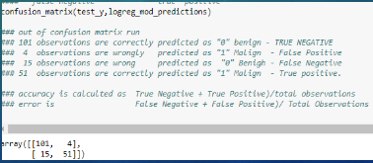
EVALUATE THE MODEL
Evaluate the model with sklearn packages using confusion_matrix and
classification_report.

Slide 17


FINAL PREDICTON
Final prediction of the model is classified below.

Slide 18
FURTHER IMPROVEMENT OF CLASSIFICATION USING KERAS
Here we use keras an open source neural network library it is capable of running on top of Tensorflow.
We have used 200770 images grouped into two classes(0&1) and after training of it by built in functions with different classifiers include (Sequential,Convolution2D,MaxPolling2D,Flattern,Dense)

Slide 19
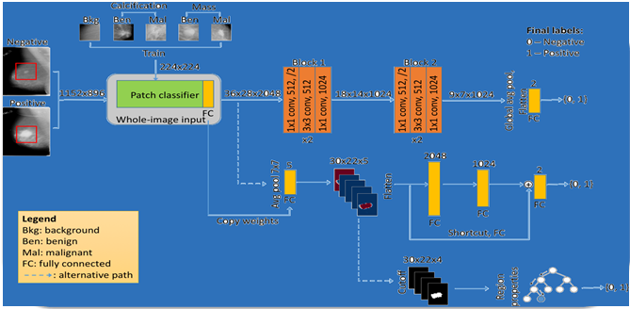
IDEA/APPROACH DETAILS

Slide 20
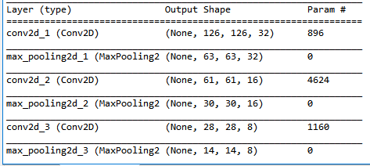
PROPERTIES OF CANCER DATA

Slide 21
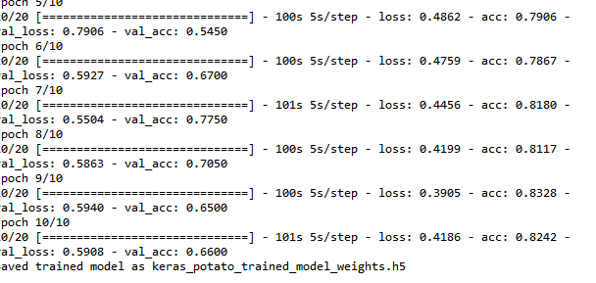
PROCESSING IMAGE DATA SET
After training of image data set the accuracy is obtainted as 82.42% for 10 Epoch

Slide 22
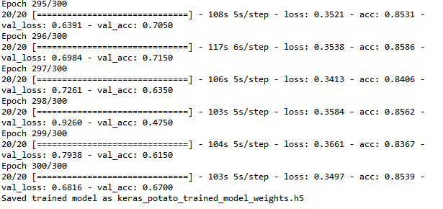
IMPROVED ACCURACY OF RESULT AFTER MORE EPOCH
After training of image data set the accuracy is obtainted as 85.39% for 300 Epoch. By increasing the number of Epoch we can get better accuracy for matching of image using logistic regression

Slide 23
ANALYZING THE RESULT

Slide 24
MODEL COMPARISION
LOGISTIC REGRESSION ->
We are getting 89% accuracy using the logistic regression model for Wisconsin dataset. And with the IDC hispathological image dataset we get 87.10% accuracy.
SUPPORT VECTOR MACHINE ->
We are getting 94.7% accuracy using SVM model for Wisconsin dataset.

Slide 25
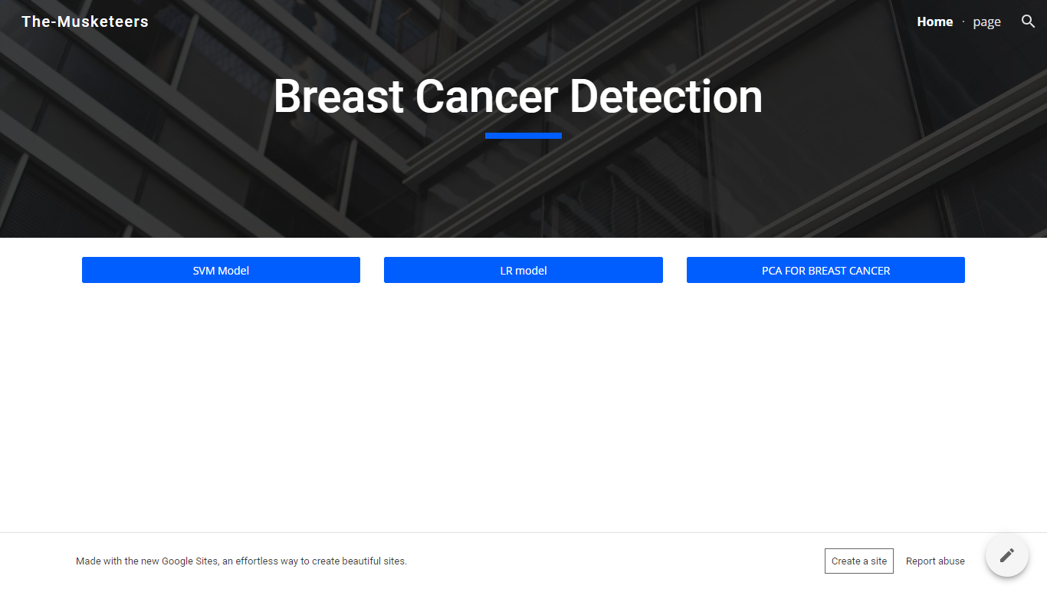
DEPLOYING THE MODEL

Slide 26
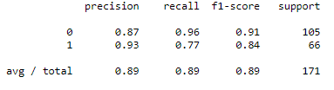
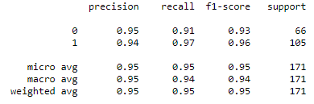
LR & SVM MODEL

Slide 27

ANY QUERIES

